Slide 1

Sequential Data and Time Series Analysis
Tim ajar kecerdasan artificial

Slide 2

Agenda
Understanding sequential data & Time Series
Hidden Markov model
Pandas library

Slide 3
Understanding sequential datA
Sequential data refers to data where the ordering is important. Whenever the points in the dataset are dependent on the other points in the dataset the data is said to be Sequential data.
Example:
Genomic Sequence Data
Human Languages
Computer Languages
Stock market prices
Applications logs
IoT activity

Slide 4
Time series data
A common example of this is a Timeseries such as a stock price or a sensor data where each point represents an observation at a certain point in time
Time series data has a lot of important characteristics that need to be modeled in order to be effectively analyzed.
Measurements for certain parameters in time series data are taken at regular time intervals.
These measurements are arranged and stored on a timeline, and the order of their appearance is critical. This order is used to extract patterns from the data.
Time series data analysis is used extensively in :
finance, sensor data analysis, speech recognition, economics, weather forecasting, manufacturing, and many more areas

Slide 5
Handling time series data with Pandas
Pandas comes from the term panel data, which is an econometrics term for datasets that include observations over multiple time periods
$ pip3 install pandas
$ pip3 install hmmlearn
$ pip3 install pystruct
$ pip3 install cvxopt
$ pip3 install timeseries

Slide 6
more functions can be performed with Pandas
DataFrame manipulation with integrated indexing
Methods to read data from a variety of different file formats and write data into in-memory data structures
Data sorting
Data filtering
Missing value imputation
Reshaping and pivoting datasets
Label-based slicing, indexing, and creation of subsets
Efficient column insertion and deletion
Group by operations on datasets
Merging and joining of datasets

Slide 7
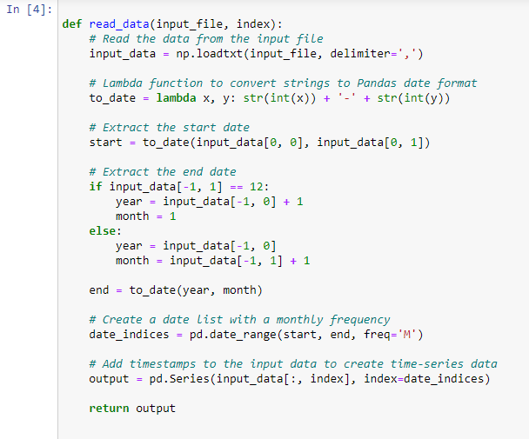
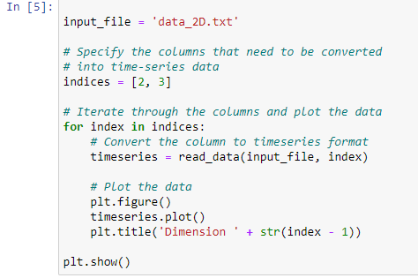
Ex. convert a sequence of numbers into time series data and visualize it
Load data from an external file
convert it into time series format
plot it and visualize it

Slide 8
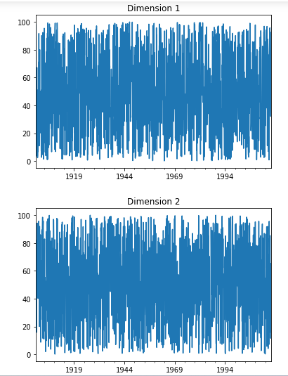

Slide 9
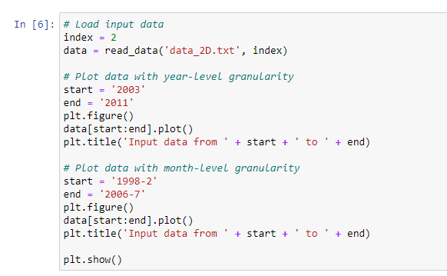
Slicing time series data
dividing the data into various sub-intervals
extracting relevant information
Instead of using indices, we will use timestamps to slice our data

Slide 10
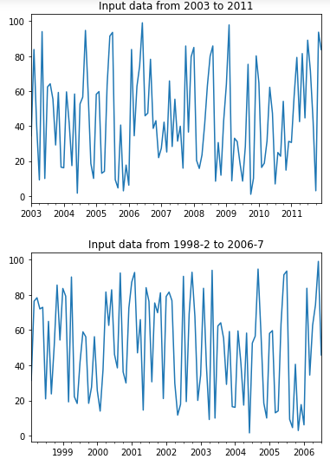

Slide 11
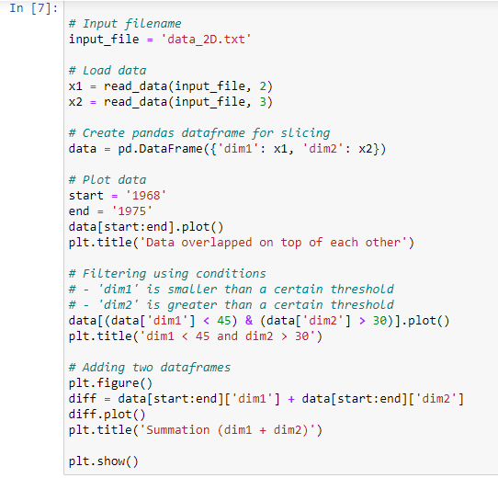
Operating on time series data
The Pandas library can operate on time series data efficiently and perform various operations like filtering and addition.
Conditions can be set, and Pandas will filter the dataset and return the right subset based on the condition.
Time series data can be loaded and filtered as well.

Slide 12
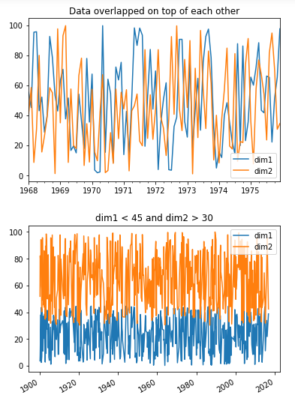
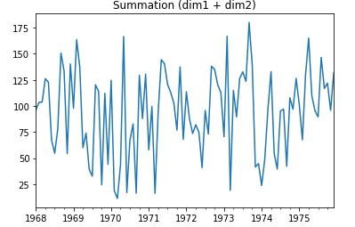
it is important before selecting and training models to understand the datasets that are being analyzed.
Pandas is a useful tool to accomplish this

Slide 13
Stock market analysis
We will analyze stock market data in this section using HMMs. This is an example where the data is already organized and timestamped.
We will use the dataset available in the matplotlib package. The dataset contains the stock values of various companies over the years.
HMMs are generative models that can analyze such time series data and extract the underlying structure. We will use this model to analyze stock price variations and generate the outputs

Slide 14
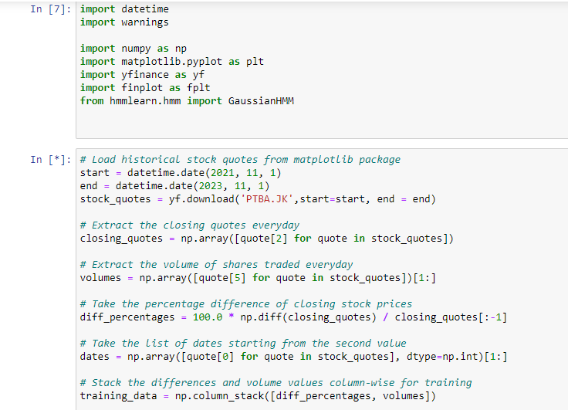

Slide 15
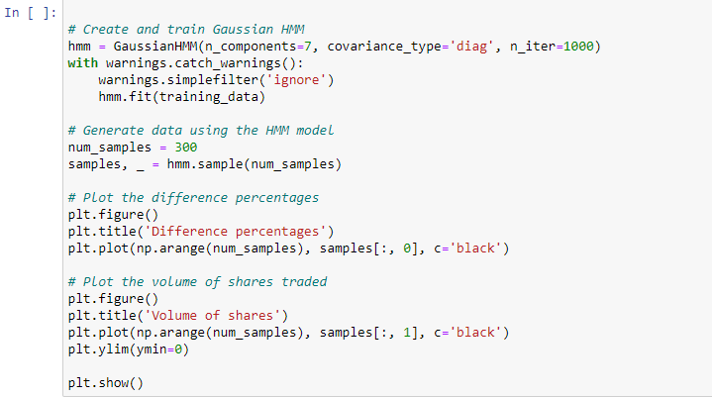

Slide 16
Hidden Markov model
Markov models are named after Andrey Markov, who first developed them in the early 1900s. Markov models are a type of probabilistic model that is used to predict the future state of a system, based on its current state. In other words, Markov models are used to predict the future state based on the current hidden or observed states.
let’s look at an example. Say you have a bag of marbles that contains four marbles: two red marbles and two blue marbles. You randomly select a marble from the bag, note its color, and then put it back in the bag. After repeating this process several times, you begin to notice a pattern: The probability of selecting a red marble is always two out of four, or 50%
The concept of a Markov model: the future state of a system is determined by its current state and past history. In the case of the bag of marbles, the current state is determined by the number of each color of marble in the bag. The past history is represented by the contents of the bag, which determine the probabilities of selecting each color of marble.

Slide 17
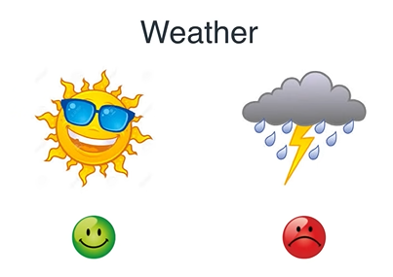
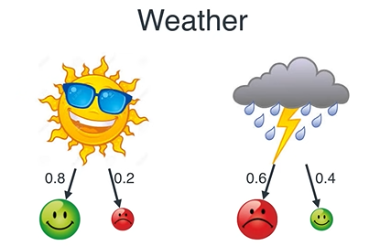
Hidden Markov model (1)

Slide 18
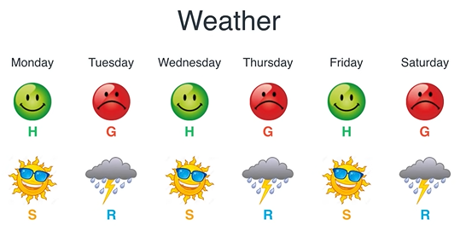
?

Slide 19
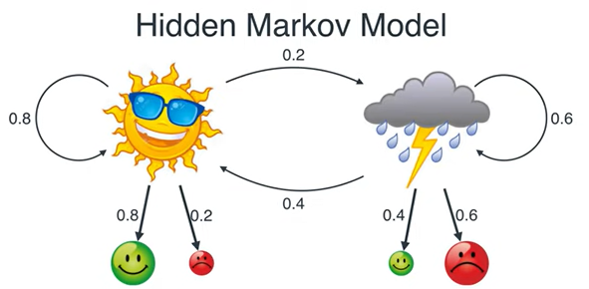
hidden state
Transition probability
emission probability
observed state

Slide 20
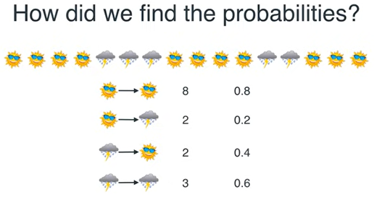
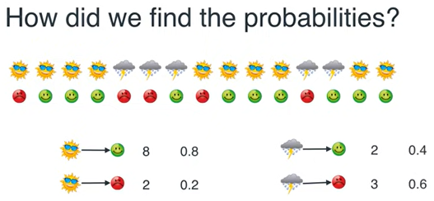


Slide 21
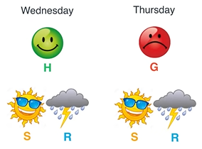
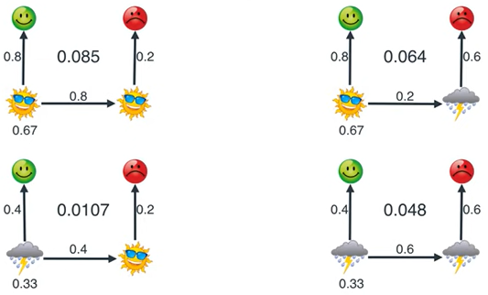
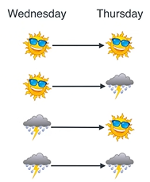
If happy-Grumpy, weather?

Slide 22

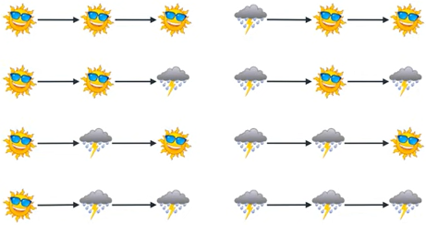
IF Happy-Grumpy-Happy, weather?

Slide 23
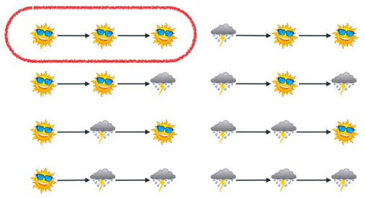
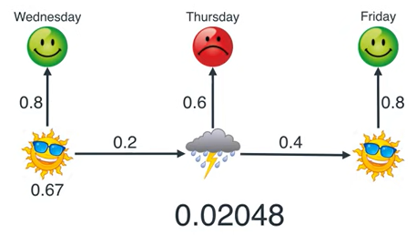
IF Happy-Grumpy-Happy, weather? (1)

Slide 24
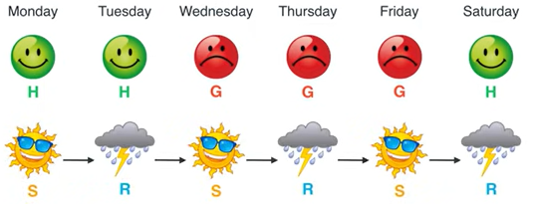
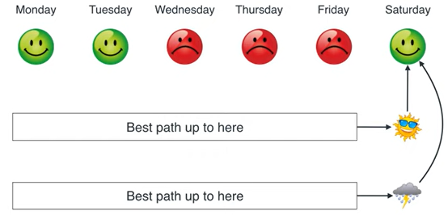
IF happy-happy-grumpy-grumpy-grumpy-happy, weather?

Slide 25
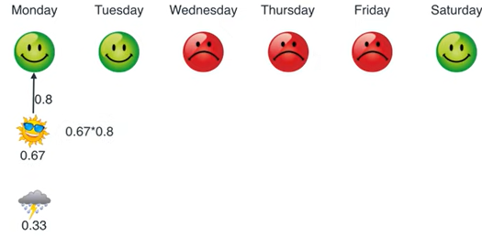
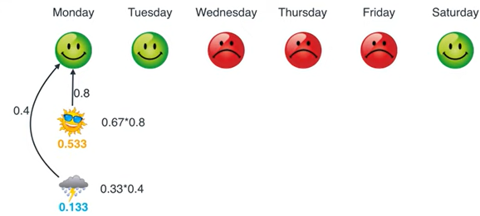
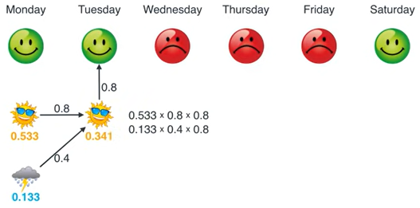
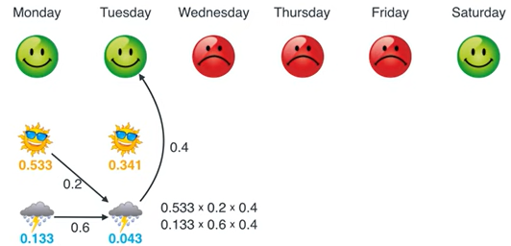
0,67
0,33

Slide 26
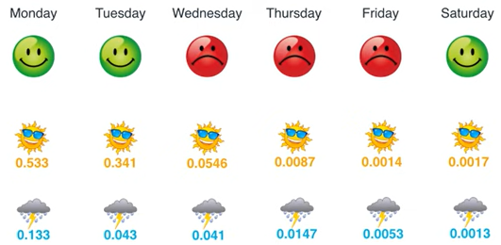

Slide 27


Thank you

